Slide 1
RMS 111 INTRODUCTION TO BUSINESS AND MANAGEMENT
Ruaha Catholic University
Lecture 07 (b): Introduction to IT Project Management
Project Life Cycle

Slide 2
Project Phases and the Project Life Cycle
A project life cycle is a collection of project phases that defines:
What work will be performed in each phase
What deliverables will be produced and when
Who is involved in each phase
How management will control and approve work produced in each phase
A deliverable is a product or service produced or provided as part of a project

Slide 3
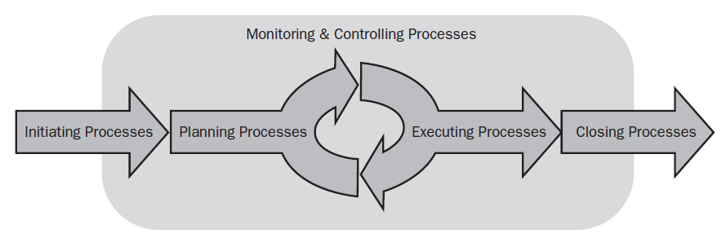
The Project Life Cycle

Slide 4
The Project Life Cycle
In early phases of a project life cycle:
Resource needs are usually lowest
The level of uncertainty (risk) is highest
Project stakeholders have the greatest opportunity to influence the project
In middle phases of a project life cycle:
The certainty of completing a project improves
More resources are needed
The final phase of a project life cycle focuses on:
Ensuring that project requirements were met
The sponsor approves completion of the project

Slide 5
Project Phase overlap
Execution
Level
Of
Activity
Planning
Initiation
Control
Closing
Project
Start
Project
Finish
TIME
Overlap of Phases in the Project Life Cycle

Slide 6
Project Initiation
Setting up the project at its inception ( Definition – creating a clear statement of what needs to be achieved, by when, with what resources)
Project initiation is the conceptual element of project management .
Project Initiation Phase specifies what the project should accomplish.
The caution in specifying this purpose is that if the customer’s needs are inadequately articulated, then poorly formulated goals and objectives will stand out as a significant source of concern.

Slide 7
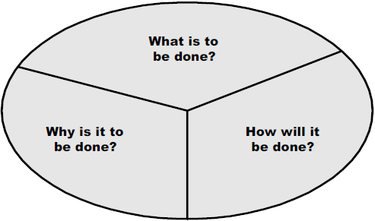
Major Questions to Be Answered During the Initiation Phase

Slide 8
Initiation Progression
Project Concept Document
Business Case
Project Charter
Planning Phase
Initiation Phase Documents

Slide 9
Initiation Phase Documents
Development of the Project Concept
Identification of the business problem / business needs
Overview of the project approach and product description
Identification of potential and recommended solutions
What is the reason for your project? Why is it important? How does it fit with the innovation challenge?
provides an understanding of what the project, if initiated, is designed to accomplish or produce. It involves an in-depth understanding of why an agency is interested in spending money and applying resources to undertake a new project
Development of the Business Case
Identification of project benefits, costs and funding .
It answers the question "What are the financial benefits, opportunities, or weaknesses of approving this project?“
Development of the Project Charter
Identification of the purpose and objectives of the project
Development of project scope
Identification of project authority and roles & responsibilities
It contains vital information about the project and its leadership.

Slide 10
A Project Charter
announces that a new project has begun.
Demonstrates management support for the project and the project manager. It is a simple, powerful tool.
It is issued at the end of the Project Initiation Phase
It marks the beginning of the Planning Phase of a project. It is used as the basis to create the Project Plan.

Slide 11
The Project Charter attributes:
There are eight major sections of the Project Charter
General Information
Project Purpose
Project Objective
Project Scope
Project Authority
Roles and Responsibilities
Management Checkpoints
Signatures

Slide 12
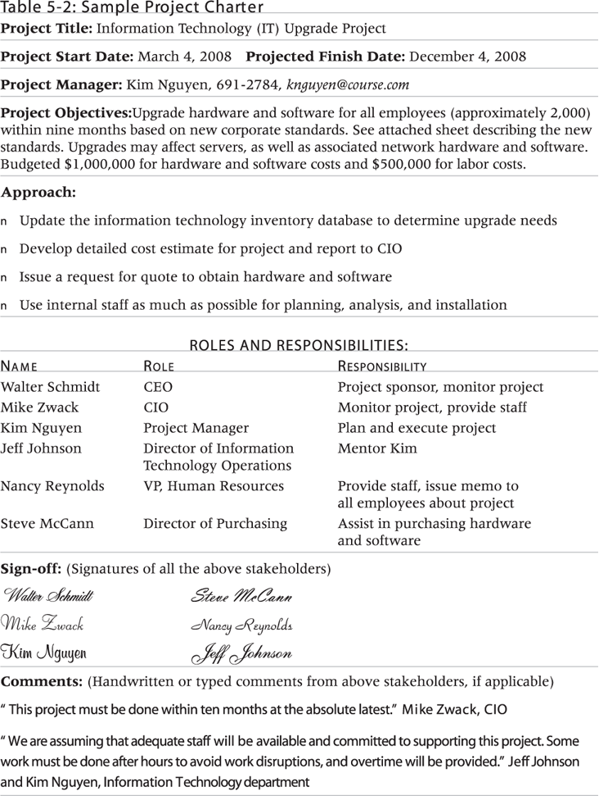
Sample Project Charter

Slide 13
The Planning Phase
detailed development of plans (time, resources, quality, Risks, scope , requirements)
The main purpose of project planning is to guide execution
Every knowledge area includes planning information
Key outputs include:
A team
A project scope statement
A work breakdown structure (WBS)
A project schedule, in the form of a Gantt chart with all dependencies and resources entered
A list of prioritized risks (part of a risk register)

Slide 14
Tasks and activities in Planning
Identify the project stakeholders
Identify the project team
Define the specific objectives
Define the specific requirements
Define the project processes

Slide 15
Scope Definition and the Project Scope Statement
What is scope management
Checking to ensure that one is completing work
Saying No to additional work not in the charter
Preventing extra work/gold plating
The preliminary scope statement, project charter, organizational process assets, and approved change requests provide a basis for creating the project scope statement
As time progresses, the scope of a project should become more clear and specific

Slide 16
Why Do We Manage Scope?
Can’t manage schedule and budget if scope is out of control (Triple Constraint)
Scope docs are used to manage expectations
TIME
Quality
SCOPE
COST

Slide 17
How Do We Manage Scope?
Five processes
Collect Requirements
Define Scope
Create WBS
Verify Scope
Control Scope
Collect
Requirements
Define
Scope
Create WBS
Verify
Scope
Control
Scope

Slide 18
Work Breakdown Structure (WBS)
Foundation of the project, all planning and controlling is based on the WBS
Identifies all work to be performed, if it is not in the WBS it does not need to be done
Graphical picture of work

Slide 19
Work Breakdown Structure
Start with major project deliverables or phases
“Decomposition” is breaking down the deliverables into more manageable parts
Not all branches need the same level of decomposition!
Decompose into “Work Packages”

Slide 20
Creating a Work Breakdown Structure
A WBS is a deliverable-oriented grouping of the work involved in a project that defines the total scope of the project
WBS is a foundation document that provides the basis for planning and managing project schedules, costs, resources, and changes
Decomposition is subdividing project deliverables into smaller pieces
A work package is a task at the lowest level of the WBS
The scope baseline includes the approved project scope statement and its associated WBS and WBS dictionary

Slide 21
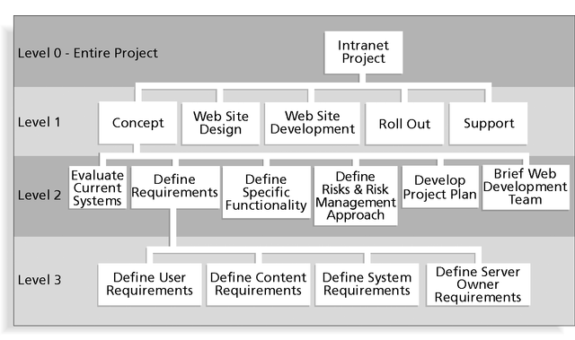
Sample Intranet WBS Organized by Phase

Slide 22
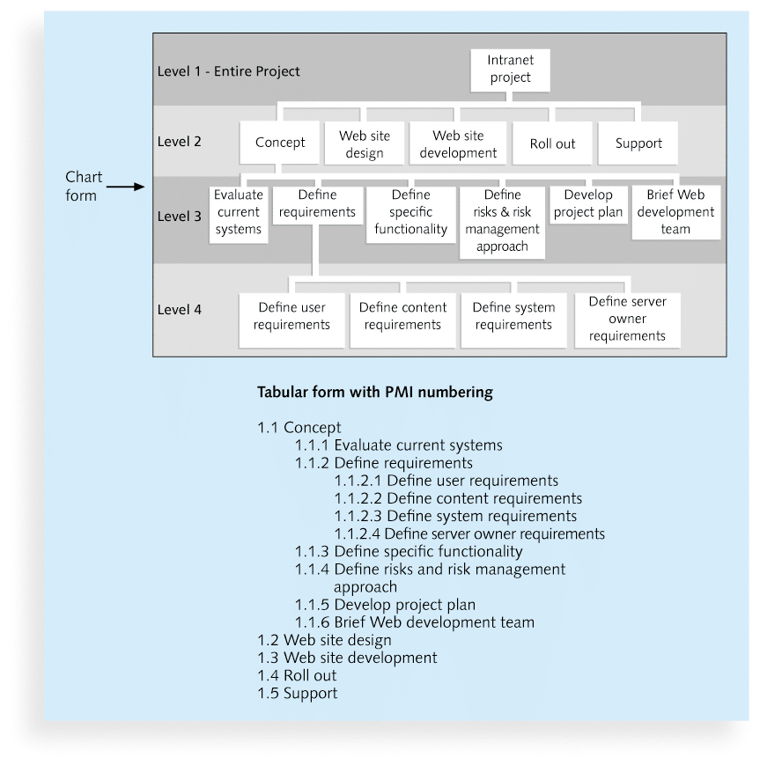

Slide 23
The WBS Dictionary and Scope Baseline
Many WBS tasks are vague and must be explained more so people know what to do and can estimate how long it will take and what it will cost to do the work
A WBS dictionary is a document that describes detailed information about each WBS item

Slide 24
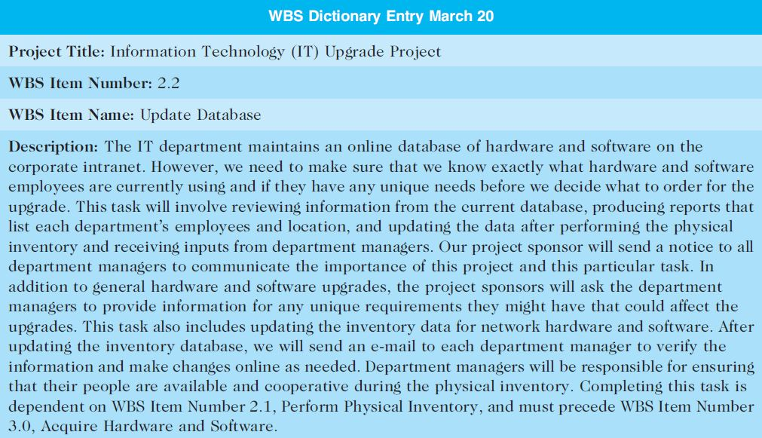
Sample WBS Dictionary Entry

Slide 25
Advice for Creating a WBS and WBS Dictionary
A unit of work should appear at only one place in the WBS.
The work content of a WBS item is the sum of the WBS items below it
A WBS item is the responsibility of only one individual, even though many people may be working on it
The WBS must be consistent with the way in which work is actually going to be performed; it should serve the project team first, and other purposes only if practical

Slide 26
Advice for Creating a WBS and WBS Dictionary (cont’d)
Project team members should be involved in developing the WBS to ensure consistency and buy-in
Each WBS item must be documented in a WBS dictionary to ensure accurate understanding of the scope of work included and not included in that item
The WBS must be a flexible tool to accommodate inevitable changes while properly maintaining control of the work content in the project according to the scope statement

Slide 27
Implementation Phase
The “doing” stage
Execute project plan and accomplish project goals

Slide 28
Closing Phase
Close-out – wrapping up the project and transferring solutions to “business as usual”
Contractual Closeout
Post Production Transition
Lessons Learned

Slide 29
END

